Slide 1
Week 4
THE relational algebra Binary operation of Cartesian Product

Slide 2
Student Objectives
Upon completion of this video, you should be able to:
Write a relational algebra expression that uses CARTESIAN PRODUCT given two tables and a query.
Given 2 tables and a CARTESIAN PRODUCT relational algebra expression, show the new table that would be returned once the expression is performed.
Determine how many attributes/columns will be in the resulting table when two tables are CARTESIAN PRODUCTED together.
Determine how many row will be in the resulting table when two tables are CARTESIAN PRODUCTED together.
Identify patterns in a CARTESIAN PRODUCT resulting table will help determine the answer to queries.

Slide 3
Cartesian Product
Creates a new table from the given 2 tables where every row in the new table is a match of each row from each table.
The new table will have all the attributes of the first table AND all the attributes of the second table
The new table’s number of rows will equal first table’s number of rows * the second table’s number of rows.
Symbol → X
Example Expression:
Table1 X Table2
Table1
ID | FirstName | LastName | Age
12 | Homer | Smith | 24
24 | Gene | Simpson | 13
45 | Walter | Reid | 45
Table1
Table2
ID | FirstName | LastName | Age
33 | Marg | Jones | 28
24 | Gene | Simpson | 13
ANSWER
ID | FirstName | LastName | Age | Table2.ID | Table2.FirstName | Table2.LastName | Table2.Age
12 | Homer | Smith | 24 | 33 | Marg | Jones | 28
24 | Gene | Simpson | 13 | 33 | Marg | Jones | 28
45 | Walter | Reid | 45 | 33 | Marg | Jones | 28
12 | Homer | Smith | 24 | 24 | Gene | Simpson | 13
24 | Gene | Simpson | 13 | 24 | Gene | Simpson | 13
45 | Walter | Reid | 45 | 24 | Gene | Simpson | 13
First Table Name
Symbol for Cartesian Product
Second Table Name

Slide 4
Example of Cartesian Product:
Table BB:
Table AA:
A | D
Horse | 11
Pig | 22
Pig | 33
A | B | C
11 | Pig | Cat
22 | Dog | Cat
AA X BB
AA.A | B | C | BB.A | D
11 | Pig | Cat | Horse | 11
22 | Dog | Cat | Horse | 11
11 | Pig | Cat | Pig | 22
22 | Dog | Cat | Pig | 22
11 | Pig | Cat | Pig | 33
22 | Dog | Cat | Pig | 33

Slide 5
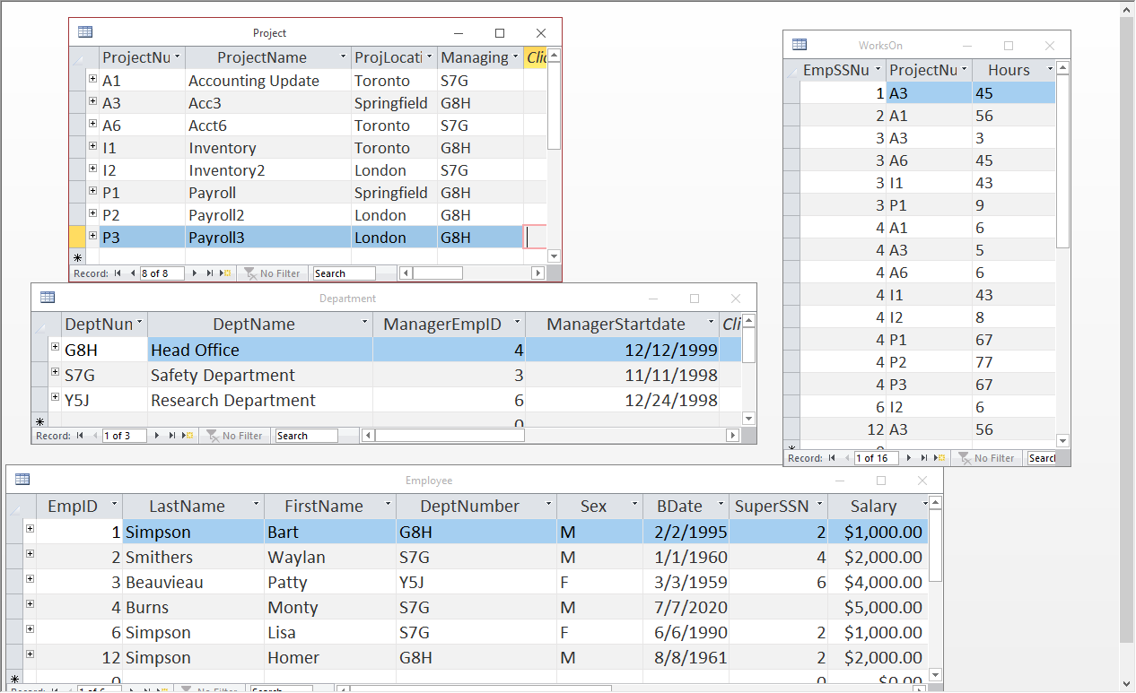
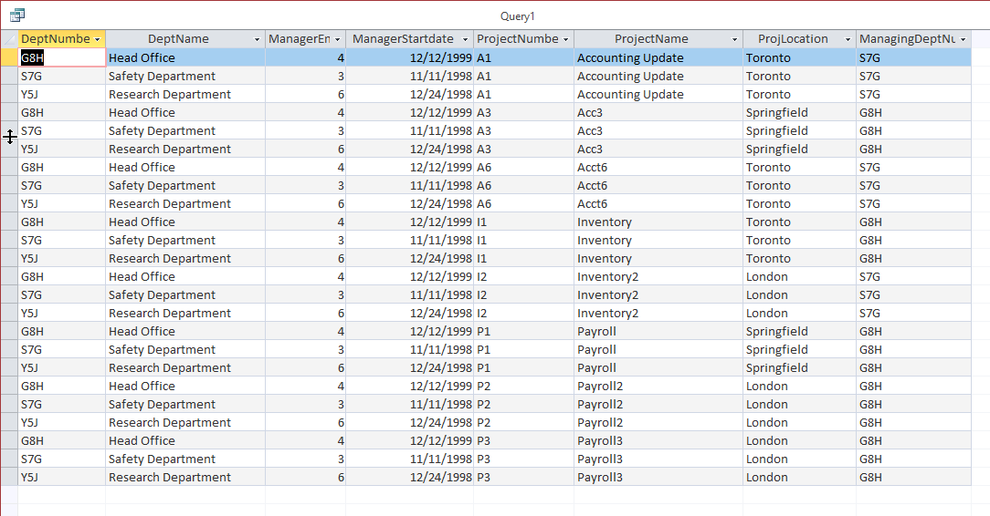
Department X Project:
QUESTION: How many tuples are above?
How many columns/attributes are there?
Where did those numbers come from?

Slide 6
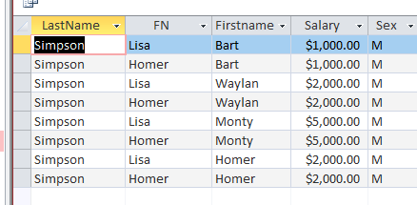
QUESTION: What would the following relational algebra expression result in?
Temp1 (LastName, FN)← π LastName, FirstName (σ EmpID > 4 (Employee))
Temp2 ← π FirstName, Salary, Sex (σ Sex = “M” (Employee))
Result ← Temp1 X Temp2
Temp1
LastName | FN
Simpson | Lisa
Simpson | Homer
Temp2
FirstName | Salary | Sex
Bart | 1000 | M
Waylan | 2000 | M
Monty | 5000 | M
Homer | 2000 | M
Result

Slide 7
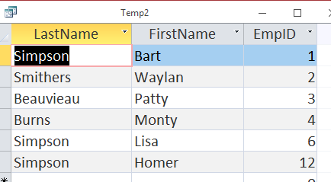
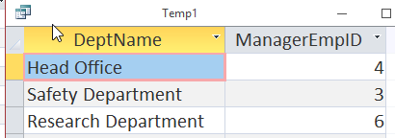
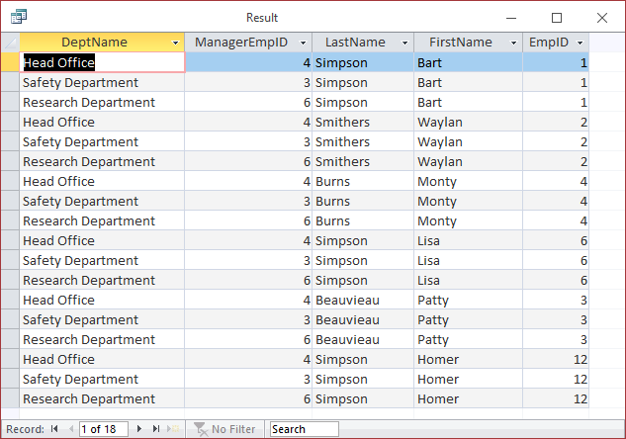
QUESTION: What would the following relational algebra expression result in?
Temp1 ← π DeptName, ManagerEmpID (Department)
Temp2 ← π LastName, FirstName, EmpID (Employee)
Result ← Temp2 X Temp1

Slide 8
QUESTION: Do you notice any patterns in the resulting relationship (Hint: Look for attributes that are equal)
QUESTION: Suppose I asked you to give me the name of the managers of the departments and their department names, how could you use the above result to answer my query (question)?
Temp1← _{π FirstName,LastName, EmpID} (Employee) Temp2← _{π DeptName,ManagerEmpID} (Department) Temp3← (Temp1 X Temp2) ANSWER← _{π FirstName,LastName, DeptName} (_{σEmpID=ManagerEmpID}( Temp3))

Slide 9
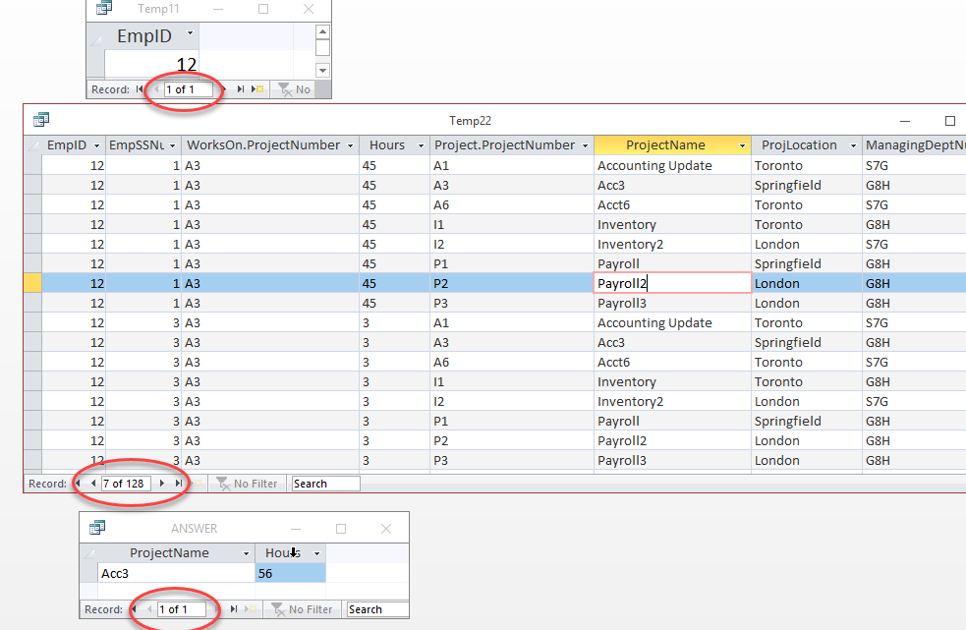
The power of Cartesian Product!
If you use a Cartesian Product WITH a Selection (and some Projections to limit down the number of attributes), you can join your tables together to figure out things like:
Who is managing the departments?
What are the names of the projects that Homer work on, and for how long on each?
What projects are managed by the “Head Office” Department?
This is how you would answer the second query above → What are the names of the projects that Homer work on, and for how long on each?
Temp11← _{π EmpID} (_{σFirstName=“Homer”}( Employee) Temp22← (Temp1 X WorksOn X Project) ANSWER← _{π Project.ProjectName,Hours} (_{σ(EmpID=EmpSSNum} AND WorksOn.ProjectNum=Project.ProjectNum)(Temp22))

